Slide 1
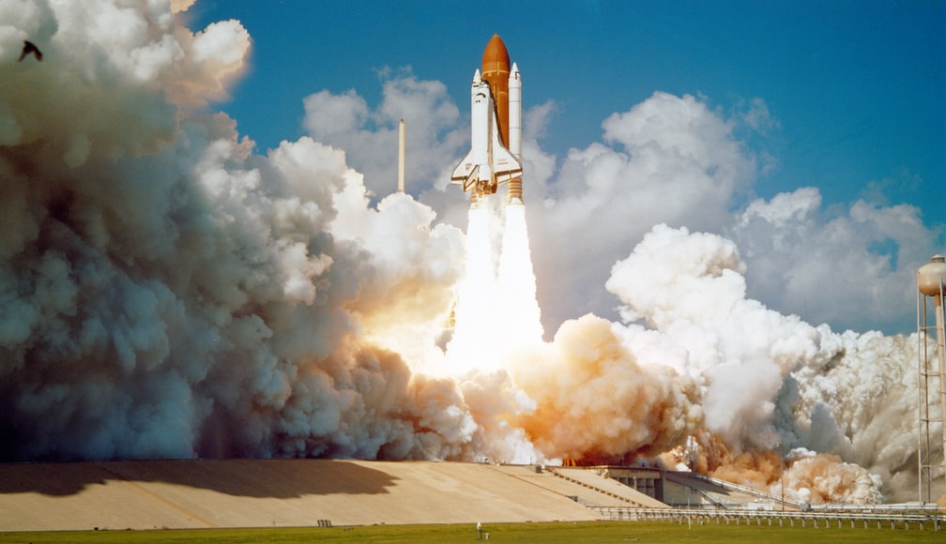
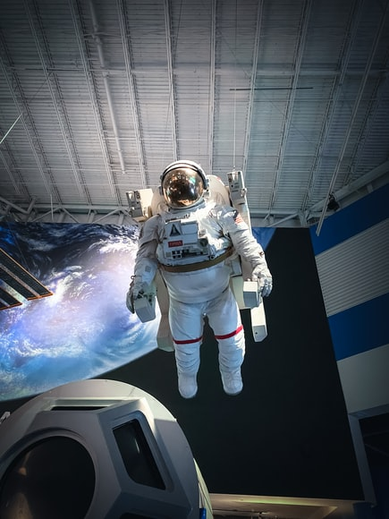
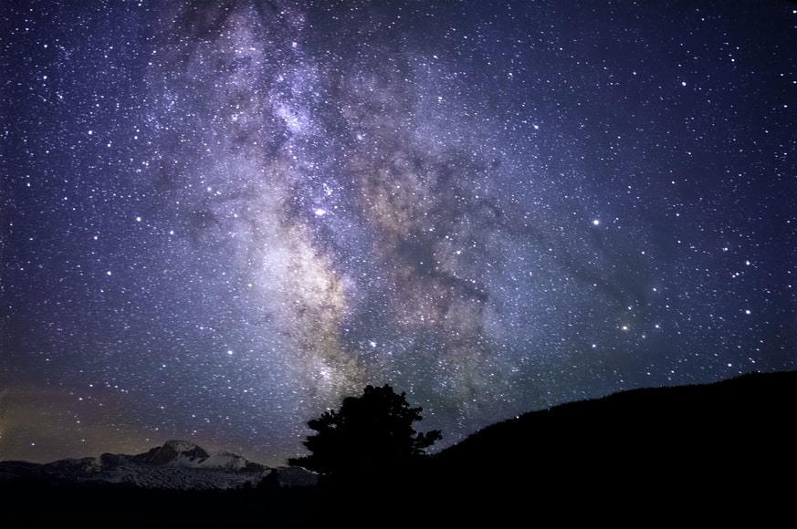





Space Explorer
Helping you learn more about space.
Brought to you by:
Notes:
Welcome to our group project called Space Explorer! Our team is Brittney Baker, Christian Beam, Jamie Williams, Tyler Torres, and Vanessa Sylverain.

Slide 2
What is Space Explorer?
Space Explorer helps you learn more about space, by:
giving you information on 10 different historical launches, including the Rocket name, the date, the status, and a description,
allowing you to view information on famous astronauts, including their picture, name, nationality, bio, their status, last flight, and a Wikipedia link for more information,
showing you the latest astronomy image of the day from NASA,
allowing you to save your images of the day.

Slide 3
CALLING ALL SPACE LOVERS!
Space Explorer was created for YOU!
We are so fortunate to live near NASA and are big fans of the space program. We are proud to share this with you!
AS A person who loves space,
I WANT to learn more about historical launches, famous astronauts, and view NASA’s astronomy image of the day,
SO THAT I have a greater appreciation for what NASA has accomplished and what it is still working so hard to provide.

Slide 4
To create this project:
HTML, CSS, Bulma, JavaScript & Jquery were used, as well as the The Space Devs API and Nasa’s Astronomy Picture of the Day API.
We met several times to discuss our ideas and find APIs that would work for us. Once we finalized our idea and found the APIs, we started to break down tasks and roles. Jamie created the repository, researched the Bulma framework, and started on the HTML and CSS using Bulma, Christian found the APIs and fetched them, Brittney, Vanessa, Christian, and Tyler worked on the JavaScript file to make it functional.
We encountered challenges right away. We had 2 other ideas and started on everything but found out the APIs wouldn’t work for us and had to change our idea TWICE!
We also had successes throughout. We had good communication skills and reported our progress daily to ensure we met our deadlines and that our project was a success!

Slide 5
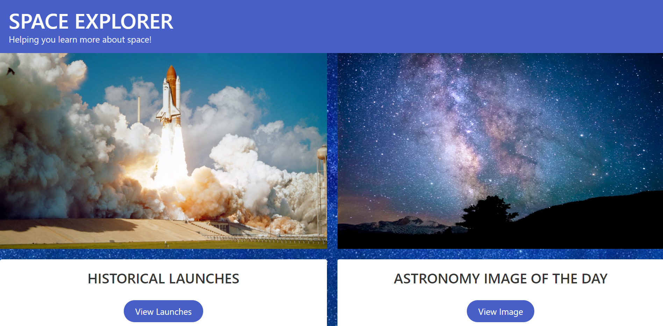
Let’s check it out now!

Slide 6
Our future plans:
We’d love to help you learn even more about space and hope to be able to one day:
Add more recent launches
Show content about the launch vehicles
Display launch locations

Slide 7
THANK YOU FOR ALLOWING US TO SHARE OUR PROJECT WITH YOU!
We hope you enjoy being a Space Explorer!
Visit our project at https://jamwil1226.github.io/space-explorer/
https://github.com/jamwil1226/space-explorer

